Slide 1
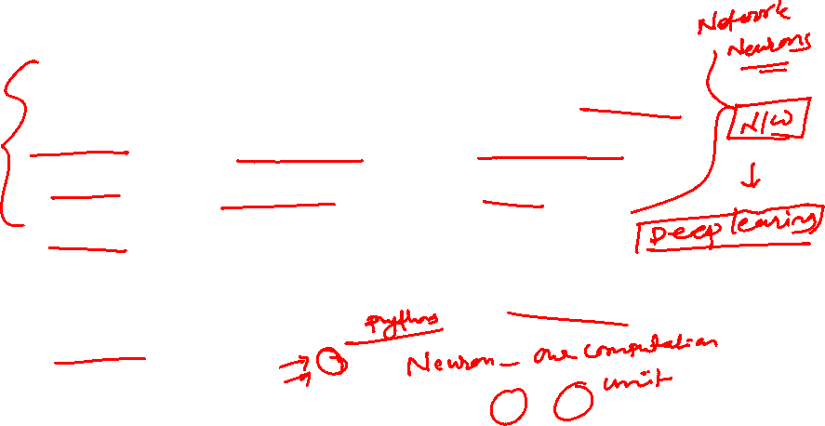
Fundamental concept
NN are constructed and implemented to model the human brain.
Performs various tasks such as pattern-matching, classification, optimization function, approximation, vector quantization and data clustering.
These tasks are difficult for traditional computers

Slide 2
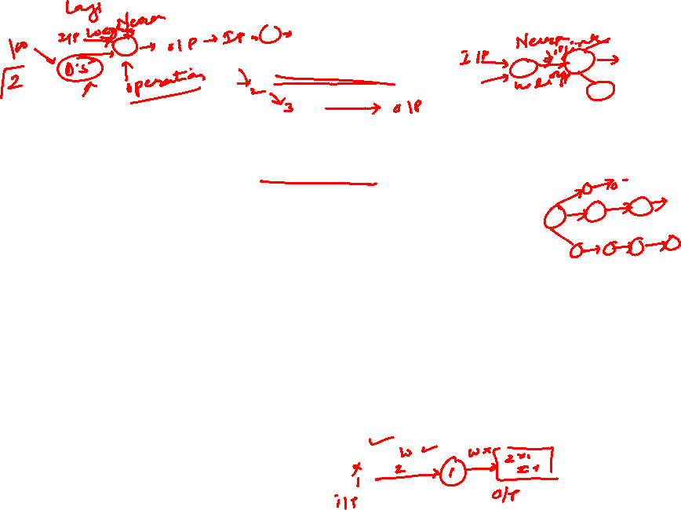
ANN
ANN posess a large number of processing elements called nodes/neurons which operate in parallel.
Neurons are connected with others by connection link.
Each link is associated with weights which contain information about the input signal.
Each neuron has an internal state of its own which is a function of the inputs that neuron receives- Activation level

Slide 3
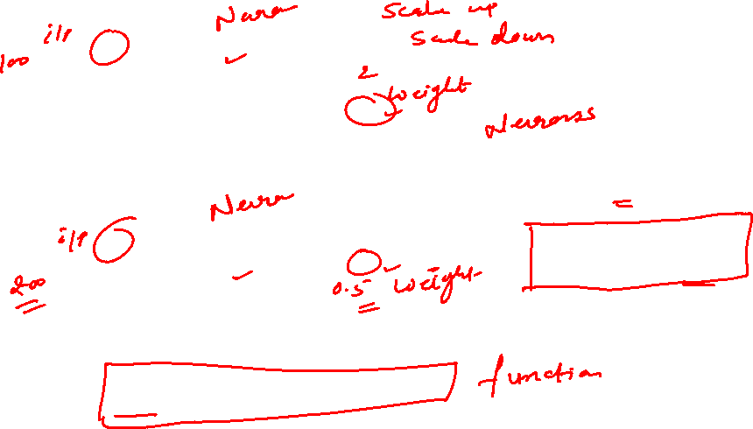

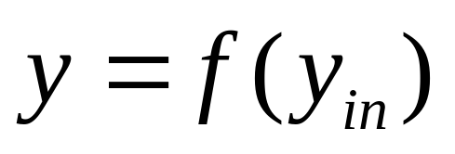
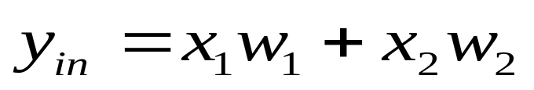
Artificial Neural Networks
x₁
X₁
w₁
Y
y
x₂
w₂
X₂

Slide 4
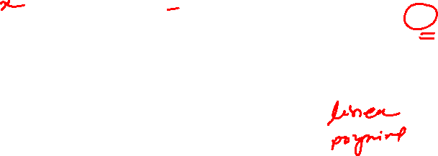
Neural net of pure linear eqn.
Input
X
m
Y
mx

Slide 5
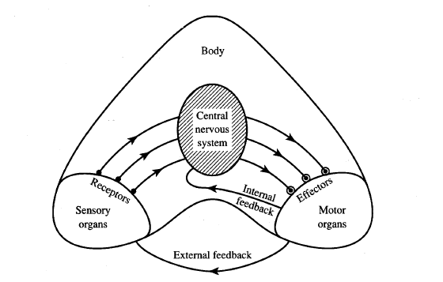
Information flow in nervous system

Slide 6
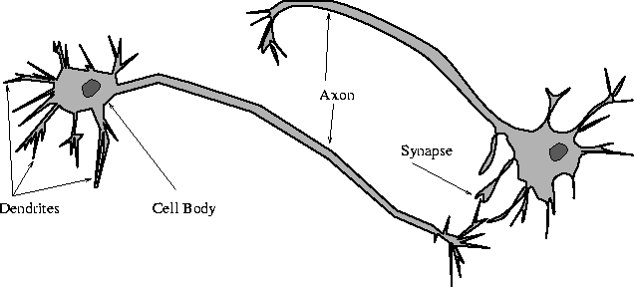
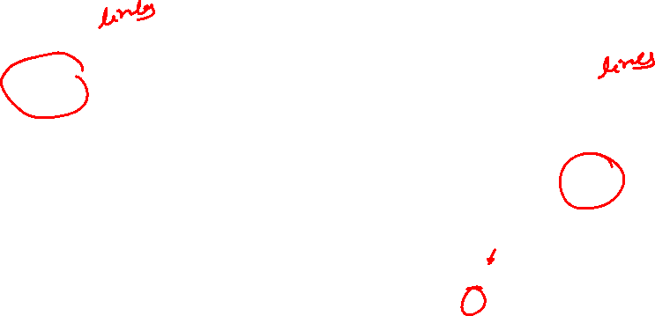
Biological Neural Network

Slide 7
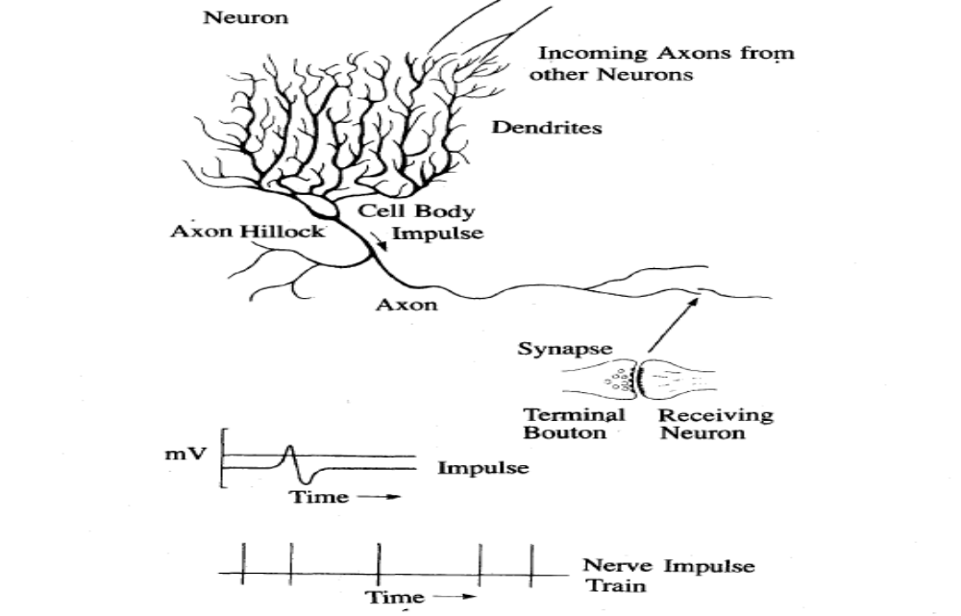

Neuron and a sample of pulse train

Slide 8
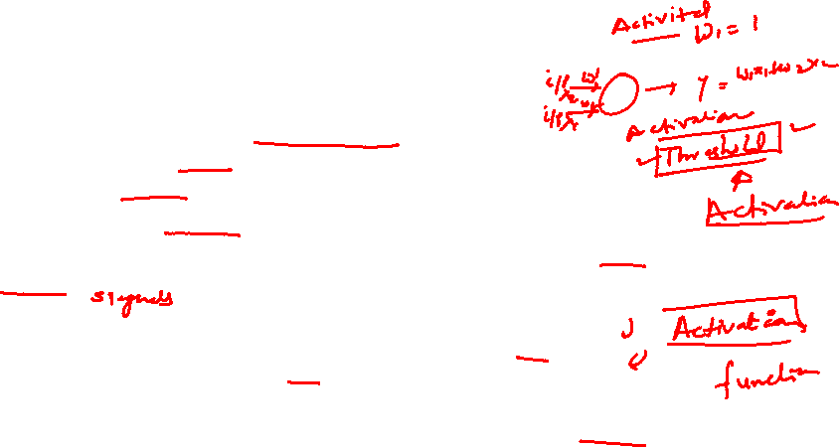
Biological Neuron
Has 3 parts
  Soma or cell body:- cell nucleus is located
  Dendrites:- nerve connected to cell body
  Axon: carries impulses of the neuron
End of axon splits into fine strands
Each strand terminates into a bulb-like organ called synapse
Electric impulses are passed between the synapse and dendrites
Synapses are of two types
  Inhibitory:- impulses hinder the firing of the receiving cell
  Excitatory:- impulses cause the firing of the receiving cell
Neuron fires when the total of the weights to receive impulses exceeds the threshold value during the latent summation period
After carrying a pulse an axon fiber is in a state of complete nonexcitability for a certain time called the refractory period.

Slide 9
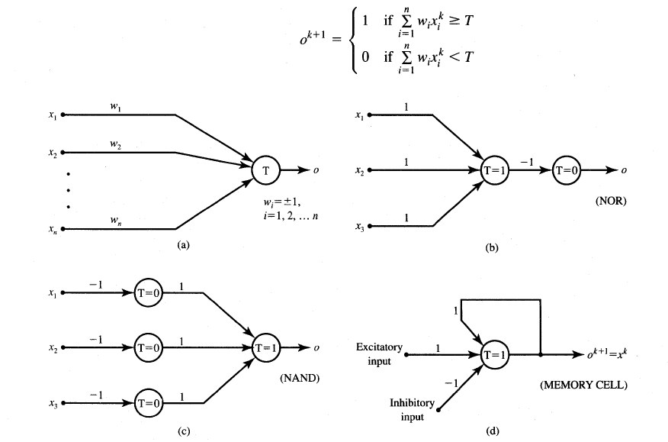
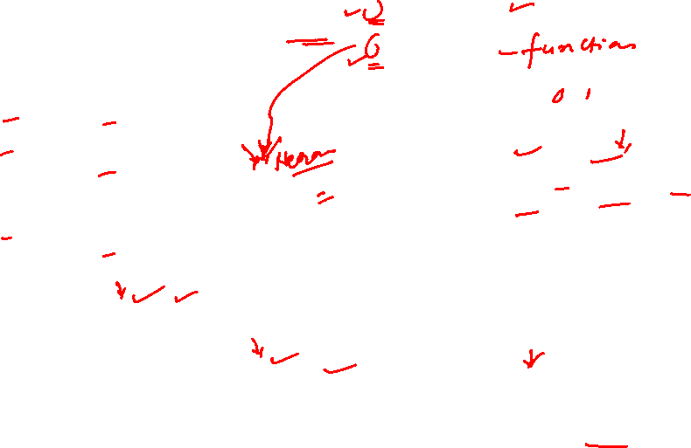
McCulloch-Pitts Neuron Model

Slide 10
Features of McCulloch-Pitts model
Allows binary 0,1 states only
Operates under a discrete-time assumption
Weights and the neurons’ thresholds are fixed in the model and no interaction among network neurons
Just a primitive model

Slide 11
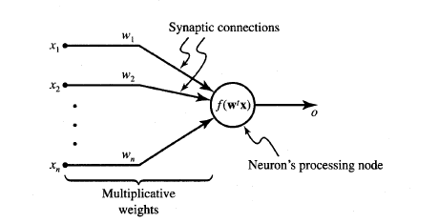
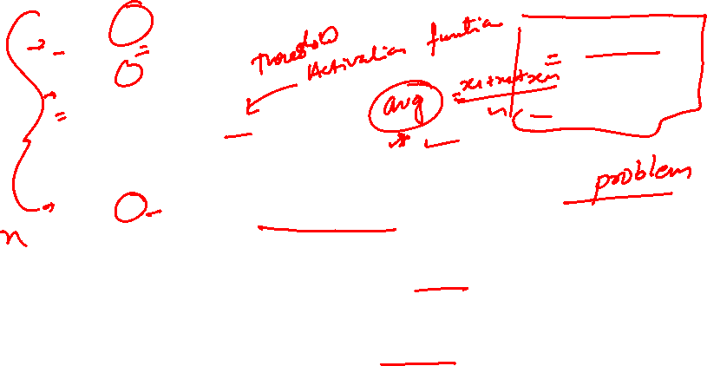
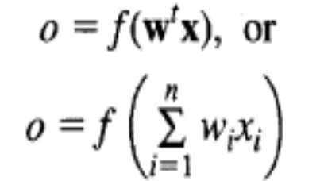
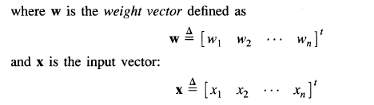
General symbol of neuron consisting of processing node and synaptic connections

Slide 12

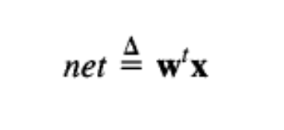
Neuron Modeling for ANN
Is referred to activation function. Domain is set of activation values net.
Scalar product of weight and input vector
Neuron as a processing node performs the operation of summation of its weighted input.

Slide 13
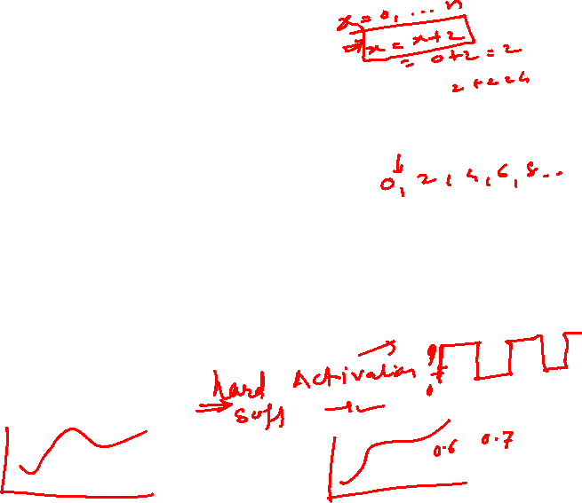
Activation function
Bipolar binary and unipolar binary are called as hard limiting activation functions used in discrete neuron model
Unipolar continuous and bipolar continuous are called soft limiting activation functions are called sigmoidal characteristics.

Slide 14
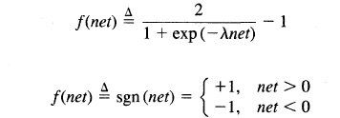


Activation functions
Bipolar continuous
Bipolar binary functions

Slide 15
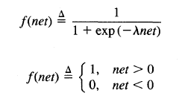

Activation functions
Unipolar continuous
Unipolar Binary

Slide 16
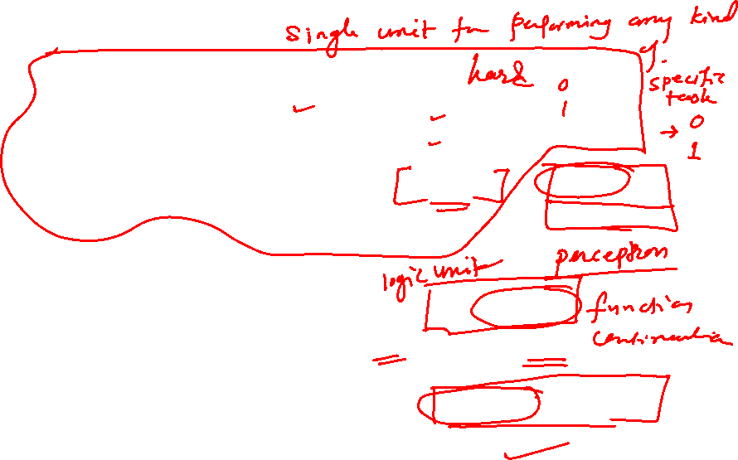
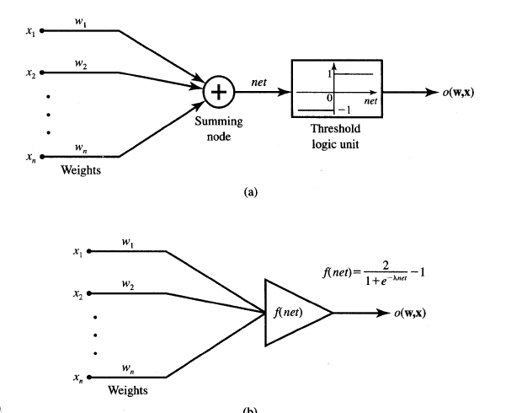
Common models of neurons
Binary perceptrons
Continuous perceptrons

Slide 17

Comparison between brain verses computer
 | Brain | ANN
Speed | Few ms. | Few nano sec. massive ||el processing
Size and complexity | 10¹¹ neurons & 10¹⁵ interconnections | Depends on designer
Storage capacity | Stores information in its interconnection or in synapse. No Loss of memory | Contiguous memory locations loss of memory may happen sometimes.
Tolerance | Has fault tolerance | No fault tolerance Inf gets disrupted when interconnections are disconnected
Control mechanism | Complicated involves chemicals in biological neuron | Simpler in ANN

Slide 18
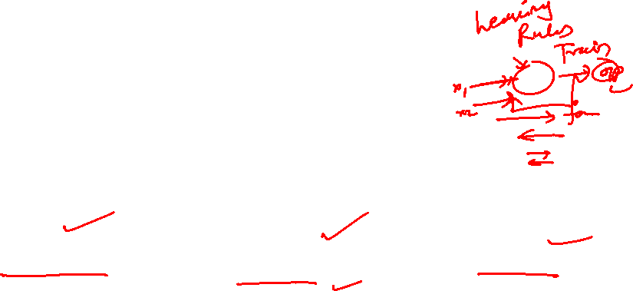
Basic models of ANN
Basic Models of ANN
Interconnections
Learning rules
Activation function

Slide 19
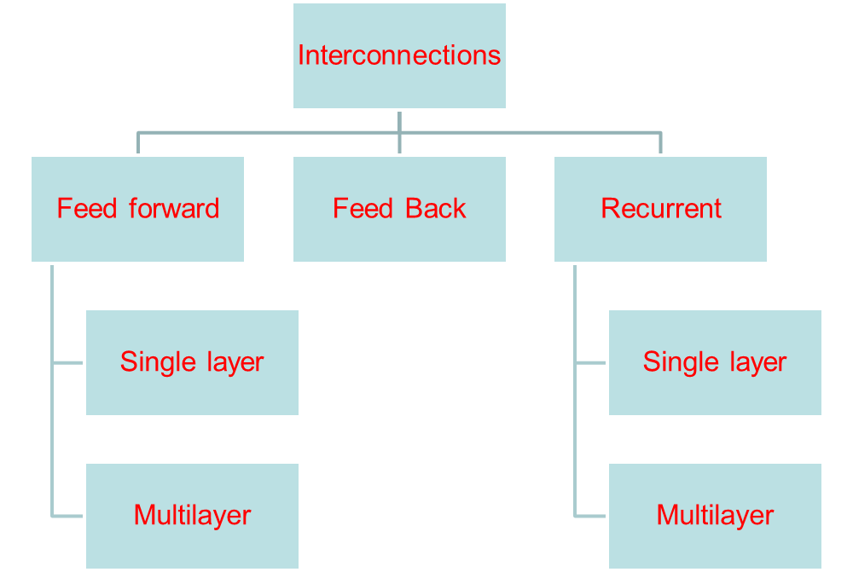

Classification based on interconnections

Slide 20
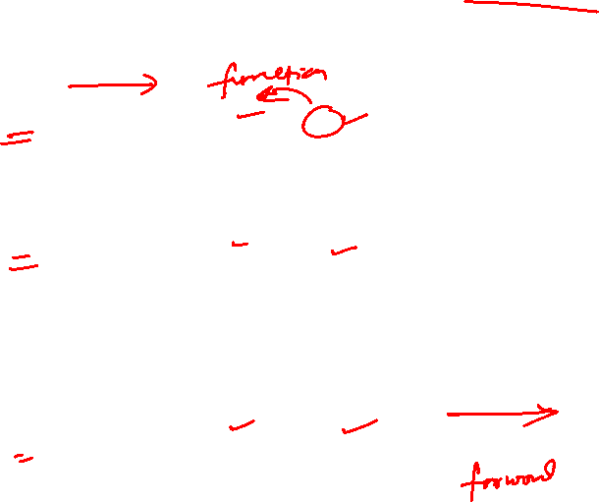
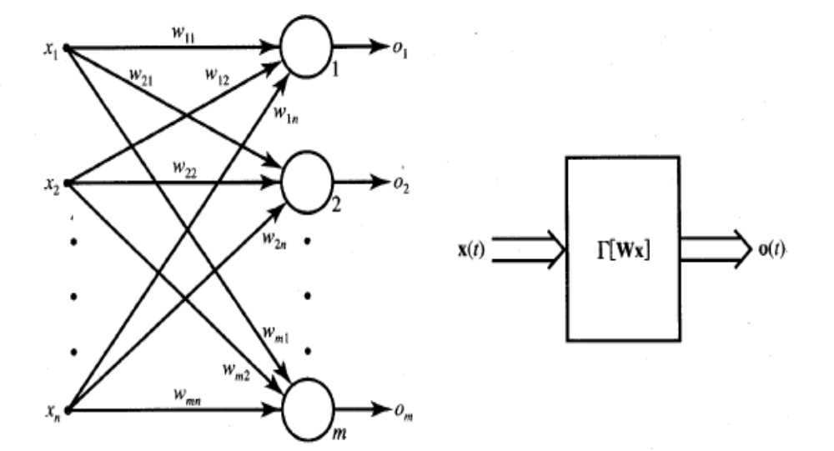
Single layer Feedforward Network

Slide 21



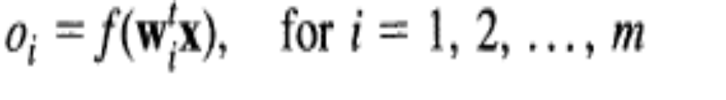
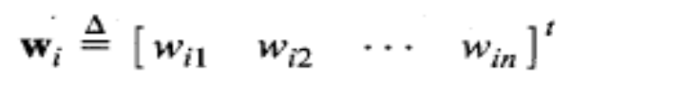
Feedforward Network
Its output and input vectors are respectively
Weight w_{ij} connects the i’th neuron with j’th input. Activation rule of ith neuron is
where
EXAMPLE

Slide 22
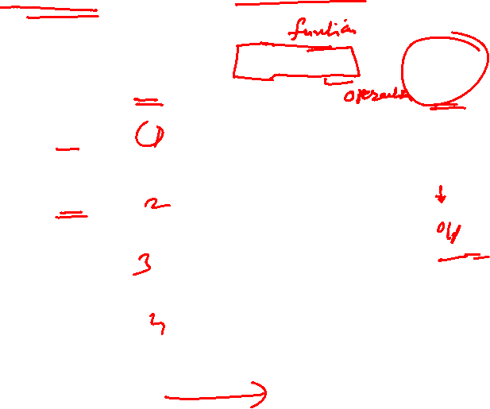
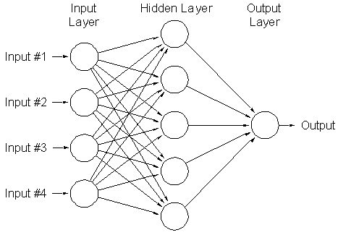
Multilayer feed forward network
Can be used to solve complicated problems

Slide 23
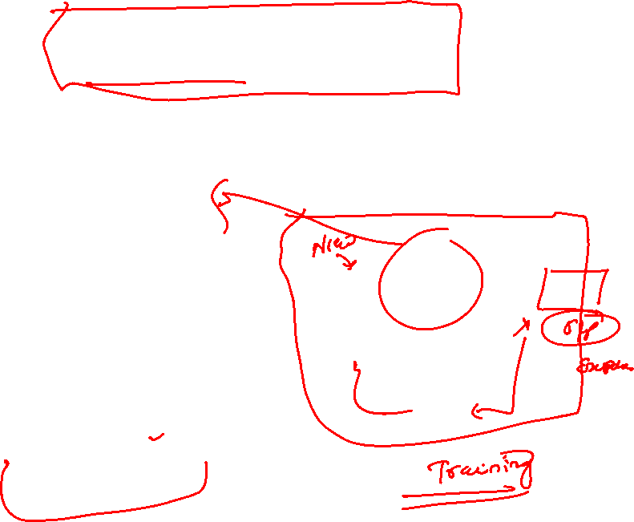
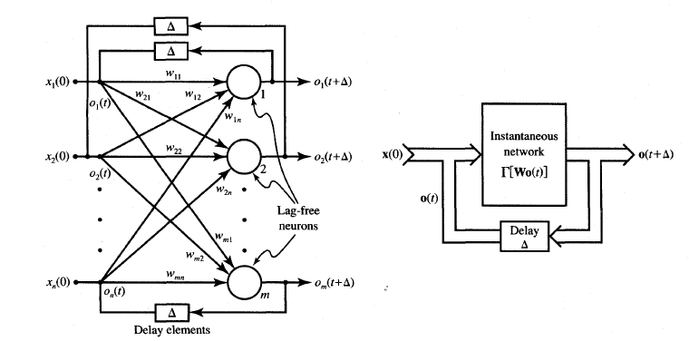
Feedback network
When outputs are directed back as inputs to same or preceding layer nodes it results in the formation of feedback networks

Slide 24
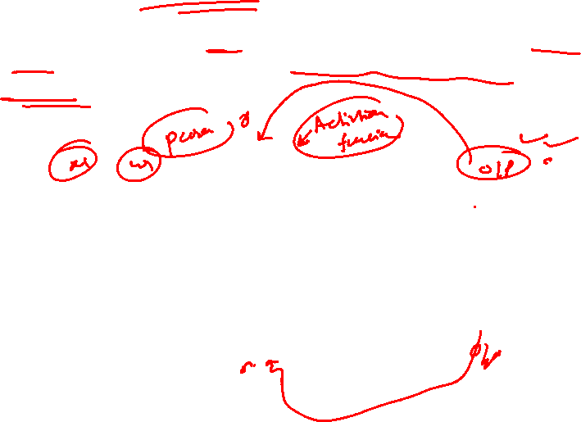
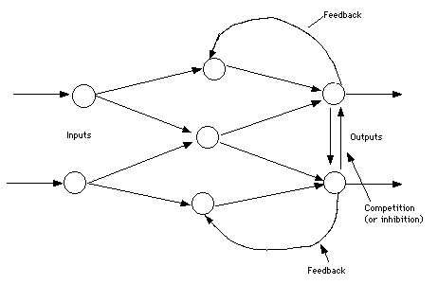
Lateral feedback
If the feedback of the output of the processing elements is directed back as input to the processing elements in the same layer then it is called lateral feedback

Slide 25
Recurrent n/ws
Feedback networks with closed loop are called Recurrent Networks. The response at the k+1’th instant depends on the entire history of the network starting at k=0.
Automaton: A system with discrete time inputs and a discrete data representation is called an automaton
Single node with own feedback
Competitive nets
Single-layer recurrent nts
Multilayer recurrent networks

Slide 26
Single node with own feedback

Slide 27
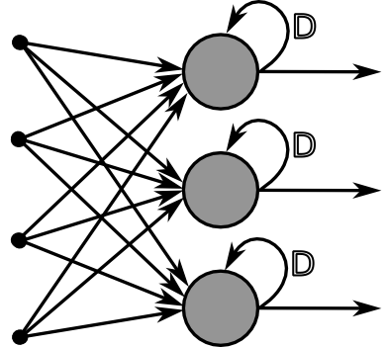
Single layer Recurrent Networks

Slide 28
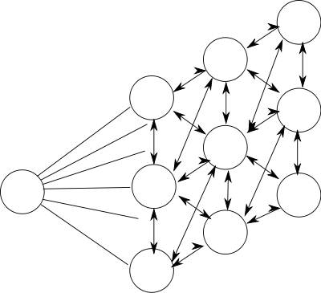
Competitive networks

Slide 29
Basic models of ANN
Basic Models of ANN
Interconnections
Learning rules
Activation function

Slide 30
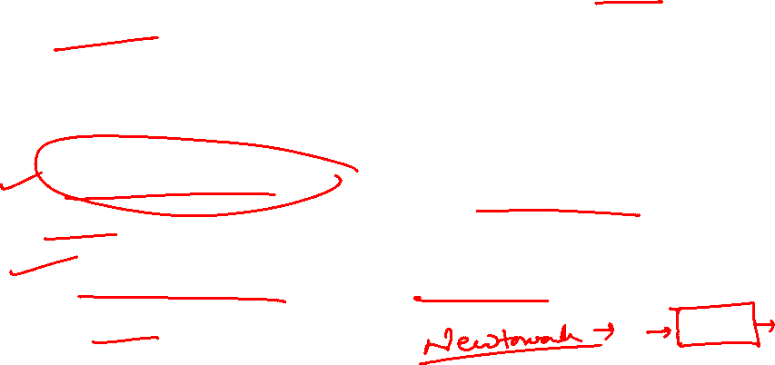
Learning
It’s a process by which a NN adapts itself to a stimulus by making proper parameter adjustments, resulting in the production of desired response
Two kinds of learning
  Parameter learning:- connection weights are updated
  Structure Learning:- change in network structure

Slide 31
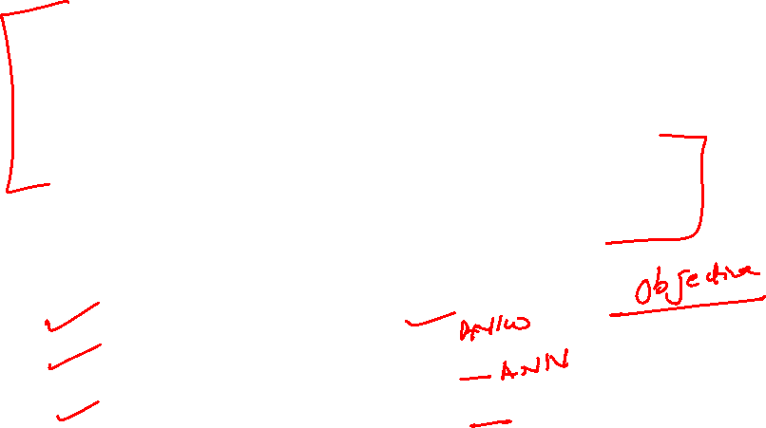
Training
The process of modifying the weights in the connections between network layers with the objective of achieving the expected output is called training a network.
This is achieved through
  Supervised learning
  Unsupervised learning
  Reinforcement learning

Slide 32
Classification of learning
Supervised learning
Unsupervised learning
Reinforcement learning

Slide 33

Supervised Learning
Child learns from a teacher
Each input vector requires a corresponding target vector.
Training pair=[input vector, target vector]
Neural
Network
W
X
Y
(Input)
(Actual output)
Error
(D-Y) signals
Error
Signal
Generator
(Desired Output)

Slide 34
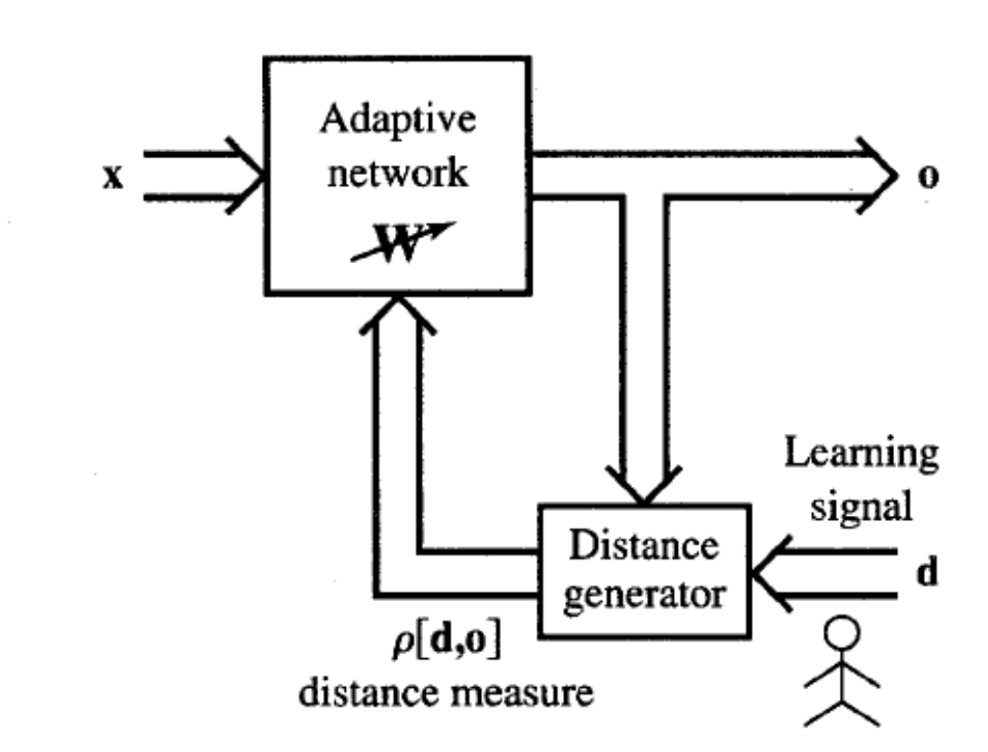
Supervised learning contd.
Supervised learning does minimization of error

Slide 35
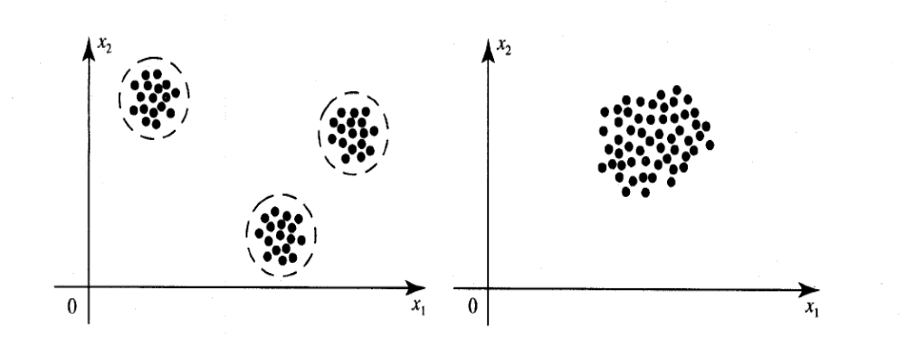
Unsupervised Learning
How a fish or tadpole learns
All similar input patterns are grouped together as clusters.
If a matching input pattern is not found a new cluster is formed

Slide 36
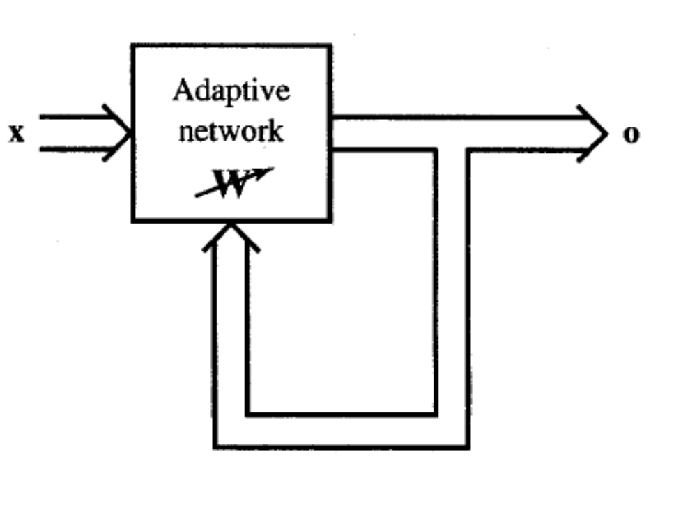
Unsupervised learning

Slide 37
Self-organizing
In unsupervised learning there is no feedback
Network must discover patterns, regularities, features for the input data over the output
While doing so the network might change in parameters
This process is called self-organizing

Slide 38
Reinforcement Learning
X
NN
W
Y
(Input)
(Actual output)
Error
signals
Error
Signal
Generator
R
Reinforcement signal

Slide 39
When Reinforcement learning is used?
If less information is available about the target output values (critic information)
Learning based on this critic information is called reinforcement learning and the feedback sent is called reinforcement signal
Feedback in this case is only evaluative and not instructive

Slide 40
Basic models of ANN
Basic Models of ANN
Interconnections
Learning rules
Activation function

Slide 41
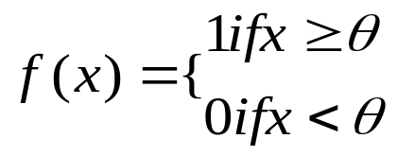
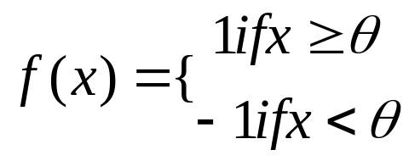
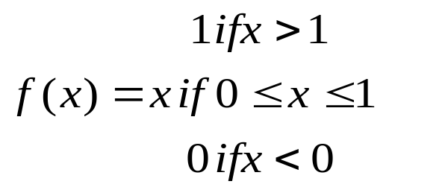
Activation Function
Identity Function
  f(x)=x for all x
Binary Step function
Bipolar Step function
Sigmoidal Functions:- Continuous functions
Ramp functions:-

Slide 42
Some learning algorithms we will learn are
Supervised:
    Adaline, Madaline
    Perceptron
    Back Propagation
    multilayer perceptrons
    Radial Basis Function Networks
Unsupervised
    Competitive Learning
    Kohenen self organizing map
    Learning vector quantization
    Hebbian learning

Slide 43
Neural processing
Recall:- processing phase for a NN and its objective is to retrieve the information. The process of computing o for a given x
Basic forms of neural information processing
  Auto association
  Hetero association
  Classification

Slide 44
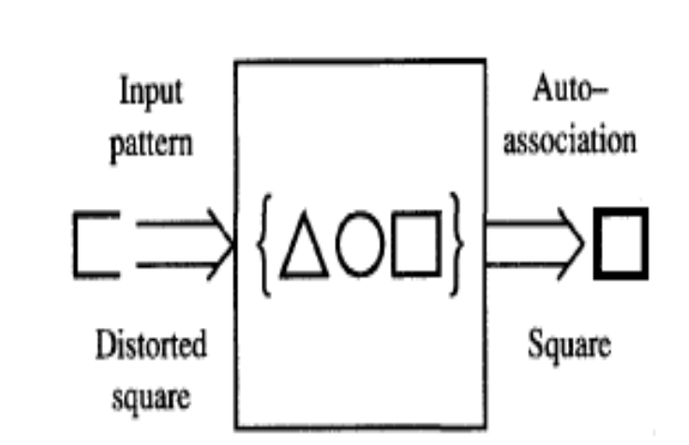
Neural processing-Autoassociation
Set of patterns can be stored in the network
If a pattern similar to a member of the stored set is presented, an association with the input of closest stored pattern is made

Slide 45
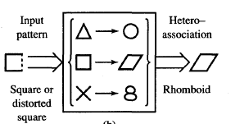
Neural Processing- Heteroassociation
Associations between pairs of patterns are stored
Distorted input pattern may cause correct heteroassociation at the output

Slide 46
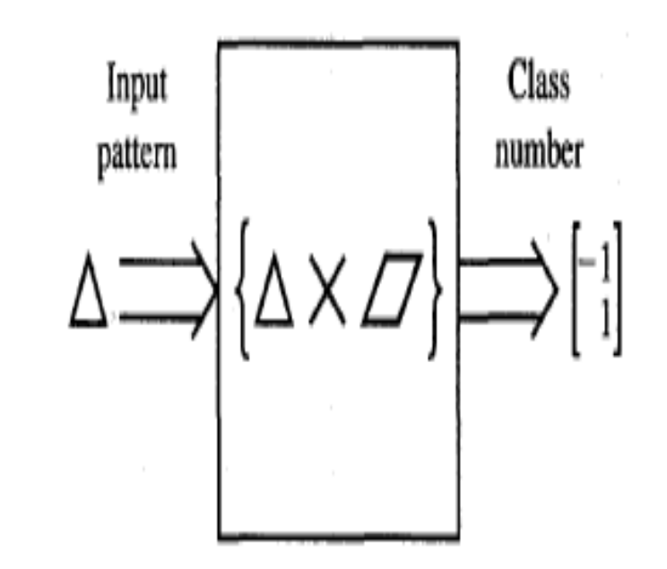
Neural processing-Classification
Set of input patterns is divided into a number of classes or categories
In response to an input pattern from the set, the classifier is supposed to recall the information regarding class membership of the input pattern.

Slide 47
Important terminologies of ANNs
Weights
Bias
Threshold
Learning rate
Momentum factor
Vigilance parameter
Notations used in ANN

Slide 48
Weights
Each neuron is connected to every other neuron by means of directed links
Links are associated with weights
Weights contain information about the input signal and is represented as a matrix
Weight matrix also called connection matrix

Slide 49
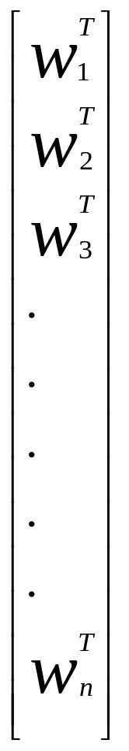
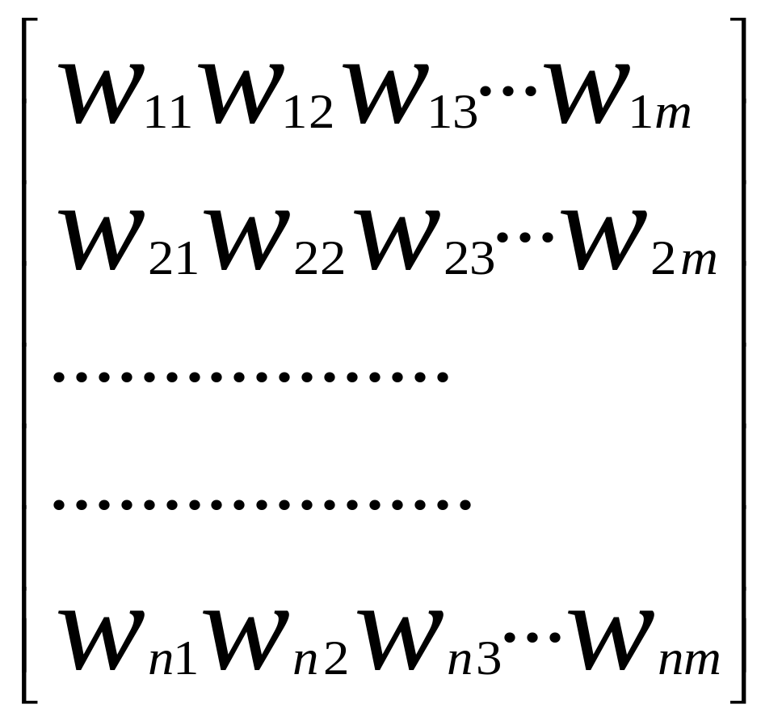
Weight matrix
W=
=

Slide 50

Weights contd…
w_{ij –}is the weight from processing element ”i” (source node) to processing element “j” (destination node)
1
X₁
b_{j}
w_{1j}
X_{i}
Y_{j}
w_{ij}
X_{n}
w_{nj}

Slide 51
Activation Functions
Used to calculate the output response of a neuron.
Sum of the weighted input signal is applied with an activation to obtain the response.
Activation functions can be linear or non linear
Already dealt
  Identity function
  Single/binary step function
  Discrete/continuous sigmoidal function.

Slide 52
Bias
Bias is like another weight. Its included by adding a component x₀=1 to the input vector X.
X=(1,X₁,X₂…X_{i},…X_{n})
Bias is of two types
  Positive bias: increase the net input
  Negative bias: decrease the net input

Slide 53
Why Bias is required?
The relationship between input and output given by the equation of straight line y=mx+c
C(bias)
Input
X
Y
y=mx+C

Slide 54

Threshold
Set value based upon which the final output of the network may be calculated
Used in activation function
The activation function using threshold can be defined as

Slide 55
Learning rate
Denoted by α.
Used to control the amount of weight adjustment at each step of training
Learning rate ranging from 0 to 1 determines the rate of learning in each time step

Slide 56
Other terminologies
Momentum factor:
  used for convergence when momentum factor is added to weight updation process.
Vigilance parameter:
  Denoted by ρ
  Used to control the degree of similarity required for patterns to be assigned to the same cluster

Slide 57




Neural Network Learning rules
c – learning constant

Slide 58



Hebbian Learning Rule
FEED FORWARD UNSUPERVISED LEARNING
The learning signal is equal to the neuron’s output

Slide 59
Features of Hebbian Learning
Feedforward unsupervised learning
“When an axon of a cell A is near enough to exicite a cell B and repeatedly and persistently takes place in firing it, some growth process or change takes place in one or both cells increasing the efficiency”
If o_{i}x_{j} is positive the results is increase in weight else vice versa

Slide 60



Final answer:

Slide 61



For the same inputs for bipolar continuous activation function the final updated weight is given by

Slide 62



Perceptron Learning rule
Learning signal is the difference between the desired and actual neuron’s response
Learning is supervised

Slide 63






Slide 64

Delta Learning Rule
Only valid for continuous activation function
Used in supervised training mode
Learning signal for this rule is called delta
The aim of the delta rule is to minimize the error over all training patterns

Slide 65






Delta Learning Rule Contd.
Learning rule is derived from the condition of least squared error.
Calculating the gradient vector with respect to wi
Minimization of error requires the weight changes to be in the negative gradient direction

Slide 66


Widrow-Hoff learning Rule
Also called as least mean square learning rule
Introduced by Widrow(1962), used in supervised learning
Independent of the activation function
Special case of delta learning rule wherein activation function is an identity function ie f(net)=net
Minimizes the squared error between the desired output value d_{i} and net_{i}

Slide 67

Winner-Take-All learning rules

Slide 68


Winner-Take-All Learning rule Contd…
Can be explained for a layer of neurons
Example of competitive learning and used for unsupervised network training
Learning is based on the premise that one of the neurons in the layer has a maximum response due to the input x
This neuron is declared the winner with a weight

Slide 69


Slide 70


Summary of learning rules

Slide 71
Linear Separability
Separation of the input space into regions is based on whether the network response is positive or negative
Line of separation is called linear-separable line.
Example:-
  AND function & OR function are linear separable Example
  EXOR function Linearly inseparable. Example

Slide 72

Hebb Network
Hebb learning rule is the simpliest one
The learning in the brain is performed by the change in the synaptic gap
When an axon of cell A is near enough to excite cell B and repeatedly keep firing it, some growth process takes place in one or both cells
According to Hebb rule, weight vector is found to increase proportionately to the product of the input and learning signal.

Slide 73
Flow chart of Hebb training algorithm
Start
1
Initialize Weights
Activate output
y=t
For
Each
s:t
Weight update
n
Bias update
b(new)=b(old) + y
y
Activate input
xi=si
Stop
1

Slide 74
Hebb rule can be used for pattern association, pattern categorization, pattern classification and over a range of other areas
Problem to be solved:
Design a Hebb net to implement OR function

Slide 75
How to solve
X1 | X2 | B | y
1 | 1 | 1 | 1
1 | -1 | 1 | 1
-1 | 1 | 1 | 1
-1 | -1 | 1 | -1
Use bipolar data in the place of binary data
Initially the weights and bias are set to zero
w1=w2=b=0

Slide 76
Inputs |  |  | y | Weight changes |  |  | weights
X1 | X2 | b | Y | W1 | W2 | B | W1(0) | W2(0) | (0)b
1 | 1 | 1 | 1 | 1 | 1 | 1 | 1 | 1 | 1
1 | -1 | 1 | 1 | 1 | -1 | 1 | 2 | 0 | 2
-1 | 1 | 1 | 1 | -1 | 1 | 1 | 1 | 1 | 3
-1 | -1 | 1 | -1 | 1 | 1 | -1 | 2 | 2 | 2

Slide 77
Home work
Using the hebb rule, find the weights required to perform the following classification that given input patterns shown in figure

